Slide 1



BY:M.HAMDOON,BASIL JOSEPH,YAHYA KHALID,ZEESHAN NASEEM. GROUP G-04
CS-112 PROJECT
CAR RENTAL AND BUYING MANAGEMENT SYSTEM

Slide 2


TOOLS USED
⇢ C++ is used as a programming language
⇢Some of the libraries used are :<iostream>,<ifstream>,<ctime><iwindows.h>,<string>
⇢ Interface used is Command line interface
⇢VsCode and Devc++ were used as the IDEs
⇢Windows was used for the OS.

Slide 3
OBJECTIVES:
⇢The projects purpose is for the automation of Car renting and purchasing processes
⇢Both Admins and customers were paid attention with regards to this sytem and their roles.
KEY FEATURES:
⇢Authentication for both admin and customers
⇢Management of Vehicles and their subtypes based on demand
⇢Transaction process and their receipt for purchase or rent

Slide 4
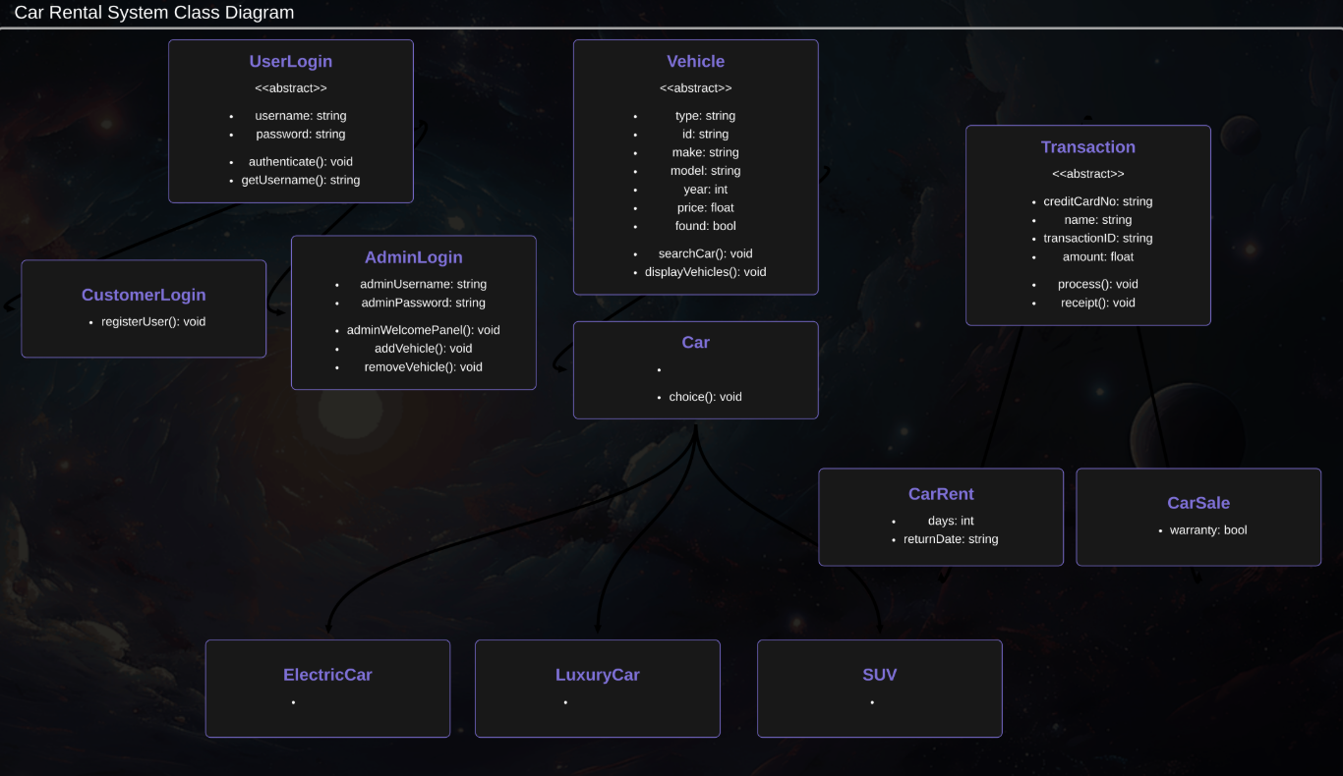
CLASS HIERARCHY

Slide 5

ENCAPSULATION:
It is used throughout the program to hide details regarding the said processes
⇢private/protected members are used throughout all classes
⇢For e.g in the transaction class private data like credit card number is private whereas interface processes like process() and receipt() are made public
⇢user login class privates the username and password only being able to access them using getter methods
CONCEPTS
USED

Slide 6
INHERITANCE:
It is used throughout the program to create hierarchy between classes
⇢Vehicle abstract base class is inherited by car which is further inherited by specialized types like suv,electric car,luxury car.
⇢Transaction base class is inherited by carrent and carsale classes aswell
⇢User login abstract baseclass is inherited by adminlogin and customerlogin
POLYMORPHISM (RUN TIME) :
It is implemented in several ways:
⇢Transaction base class showcases the use of pure virtual functions like process() and receipt() which are after that overridden in derived classes like carrent and carsale with their individual implementations
⇢vehicle and userlogin are abstract base classes that contain pure virtual
functions like searchcar( ), display vehicles( ), authenticate( ) forcing derived classes to implement these methods so that they dont get abstract themselves

Slide 7
ABSTRACTION:
It is implemented in several ways:
⇢Abstract base classes like vehicle, userlogin and transaction define interfaces without any implementation
⇢hiding complex operations like process() in transaction class

Slide 8
CHALLENGES
⇢ File permission issues: permission denied when trying to remove files or access files in the program. So we tried to implement proper file handling with error checking
⇢Irregular looping problems: sometimes when printing the receipt the program would give improper loops that go on till infinite resolution fixed it by adding breaks in the loops where required
⇢Files not displaying: sometimes the cars would not display properly due to invalid string formatting in files so we fixed it with proper formatting39%

Slide 9
TESTING:
⇢ Unit Testing:
Verified correct login/logout functionality and tested all admin operations to add and remove cars.
also tested all transaction and receipt processes
⇢Integration Testing:
Verified all the work done from login to transaction part of the program
⇢Edge cases:
Using numbers as input instead of string when required causes infinite loops.
Empty files causes nothing to display aswell.

Slide 10
IN
THE
FUTURE
1.Better reports for the admin:
⇢ Generate daily and weekly reports for the admin to analyze and export them to an excel sheet
2.Filter Options:
⇢ Filter vehicles based on their price ranges and search by more criterias aswell
3.Better Payment:
⇢ Support for multiple payment method and confirmation email for payment
4.Gui Implementation:
⇢ switch from CLI to GUI

Slide 11
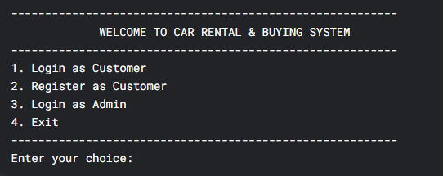
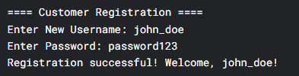
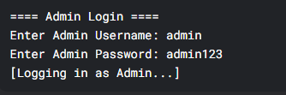
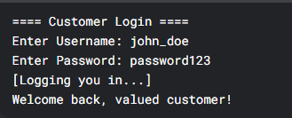
OUTPUTS:
AUTHENTICATION:
USER:
ADMIN:

Slide 12
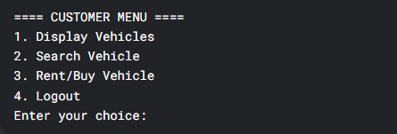
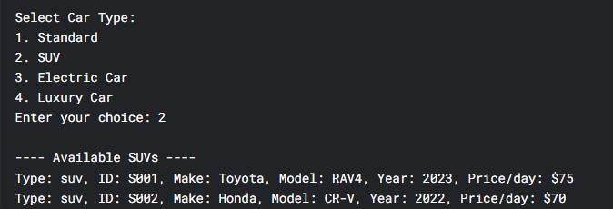
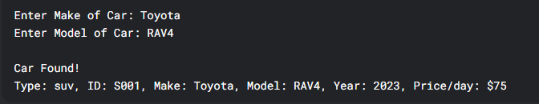
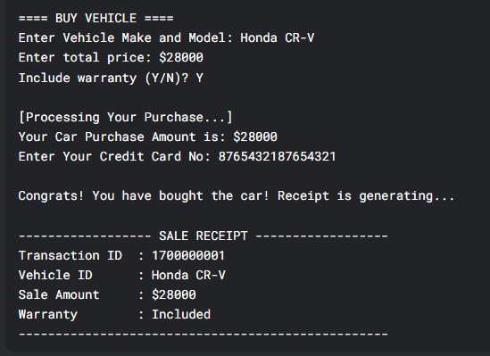
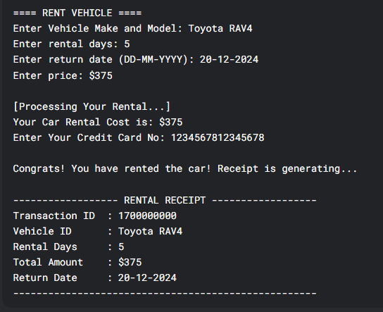
OUTPUTS:
CUSTOMER FUNCTIONS:

Slide 13
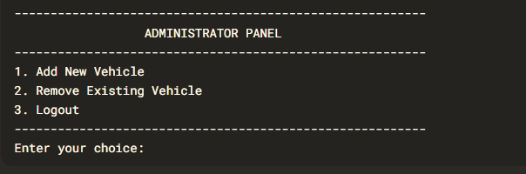
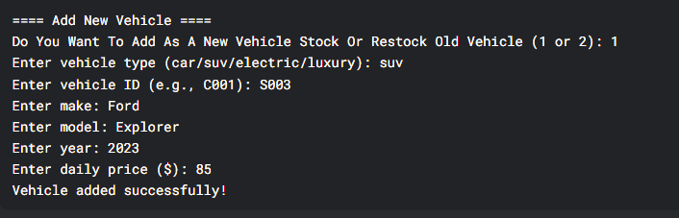
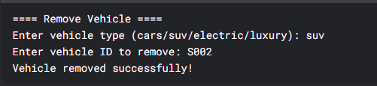
OUTPUTS:
ADMIN FUNCTIONS:

Slide 14
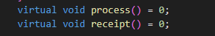
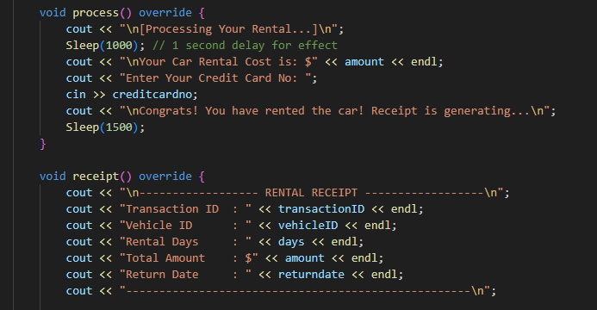
INHERITANCE:
POLYMORPHISM(RUN TIME):
TRANSACTION CLASS:
CAR RENT CLASS:

Slide 15
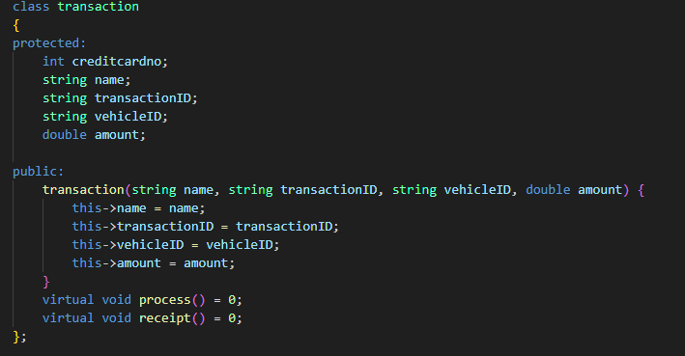
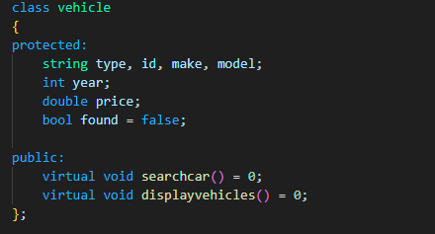
ABSTRACTION AND ENCAPSULATION:

Slide 16
THANK YOU
THE END.

